Slide 1
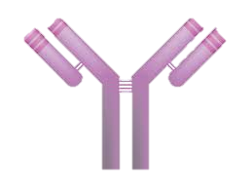
Unit 2: Module 2.1
Immunoglobulin Classes & Subclasses
Antibodies, Receptors & MHC
Dr. (Ms.) Sonali Correa
MSc., PhD.

Slide 2
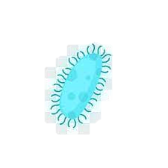
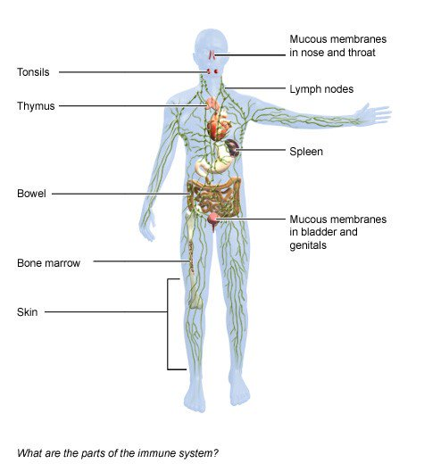
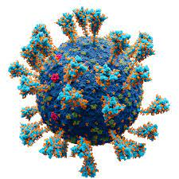

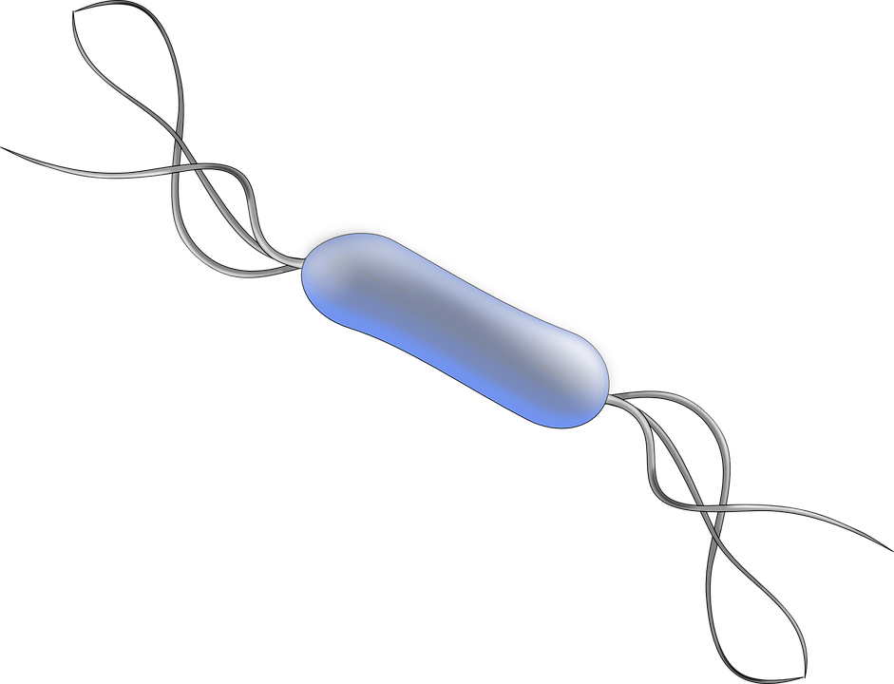
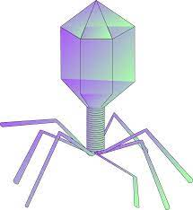
Immune system
Notes:
The immune systems is the basic defense system of the body which consists of various types of cells that kills the harmful microorganisms pathogens and protects us from diseases and illnesses

Slide 3
Immune System
Innate
Adaptive or Acquired
Passive
First line of defence
Physical barriers and Chemical barriers
Function and efficiency do not change with repeated exposure to foreign pathogens.
Is activated when the innate system fails
Consists lymphocytes and antibodies being the key elements
Lymphocytes arise continuously from progenitor cells in the bone marrow & synthesize cell surface receptors or secrete proteins that specifically bind to foreign molecules.
These secreted proteins are known as antibodies. Any molecule that can bind to an antibody is called an antigen.
The term antibody is used interchangeably with immunoglobulin.
Passive immunity is "borrowed" from another source and it lasts for a short time.
For example, antibodies in a mother's breast milk give a baby temporary immunity to diseases the mother has been exposed to.

Slide 4
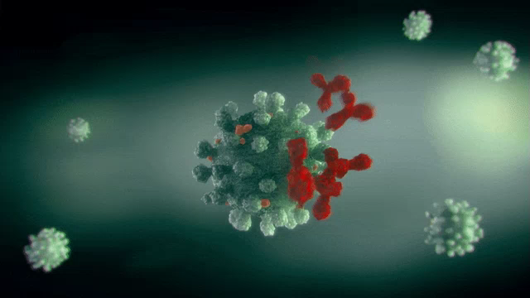
Immunoglobulin
Immunoglobulins (Ig), also known as antibodies (Ab), are glycoprotein molecules produced by plasma cells or white blood cells
They recognize and bind to specific epitopes (the part of an antigen molecule to which an antibody attaches itself) on antigens
Present on B cell membrane & secreted by plasma cells, and they circulate in blood, where they eliminate/neutralize an antigen

Slide 5
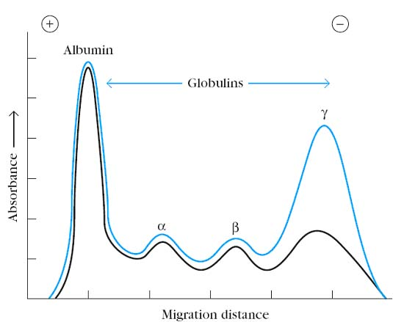
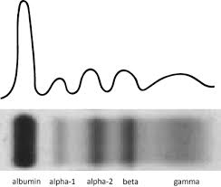
Immunoglobulins constitute of 20-25% of serum proteins
Immunoglobulins
Tiselius (1937), Swedish biochemist carried out the serum electrophoresis (immune sera) which separated in 4 fractions (albumin, alpha-, beta- & gamma globulins)
Most antibody activity was found in Gamma globulin & thus antibody molecule is considered as “Gamma-globulin fraction”
As they immunologically react with the antigen, they were given the name Immunoglobulin
Tiselius A. Electrophoresis of serum globulin: Electrophoretic analysis of normal and immune sera. Biochem J. 1937 Sep;31(9):1464-77. doi: 10.1042/bj0311464. PMID: 16746478; PMCID: PMC1267100.
Tiselius, Arne and Elvin A. Kabat. “AN ELECTROPHORETIC STUDY OF IMMUNE SERA AND PURIFIED ANTIBODY PREPARATIONS.” The Journal of Experimental Medicine 69 (1939): 119 - 131

Slide 6
STRUCTURE OF IG

Slide 7
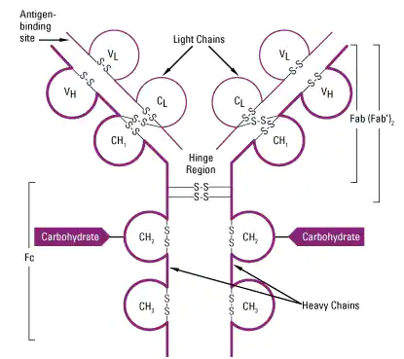
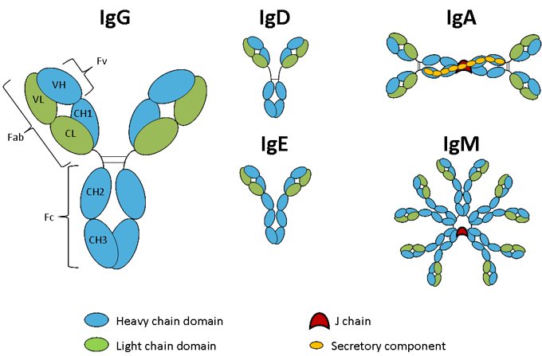
Ig | Heavy Chain
IgG | Gamma γ
IgA | Alpha α
IgM | Mu μ
IgD | Delta δ
IgE | Epsilon ε

Slide 8
  Made of 4 polypeptide chains: 2 heavy chains (H) & 2 light chains (L)
  Structure is divided into 2 regions: Constant & variable
  2 fragment: Fc fragment (Fragment crystallizable) & Fab (antigen-binding) fragment
  The amino terminal ends of the polypeptide chains show considerable variation in amino acid composition and are referred to as the variable (V) regions to distinguish them from the relatively constant (C) regions.
  Each L chain consists of one variable domain, VL, and one constant domain, CL.
  The H chains consist of a variable domain, VH, and three constant domains CH1, CH2 and CH3.
  Each heavy chain has about twice the number of amino acids and molecular weight (~50,000) as each light chain (~25,000), resulting in a total immunoglobulin monomer molecular weight of approximately 150,000.
  Heavy and light chains are held together by a combination of non-covalent interactions and covalent interchain disulfide bonds, forming a bilaterally symmetric structure.
  The V regions of H and L chains comprise the antigen-binding sites of the immunoglobulin (Ig) molecules. Each Ig monomer contains two antigen-binding sites and is said to be bivalent.
  The hinge region is the area of the H chains between the first and second C region domains and is held together by disulfide bonds. This flexible hinge (found in IgG, IgA, and IgD, but not IgM or IgE) region allows the distance between the two antigen-binding sites to vary.

Slide 9
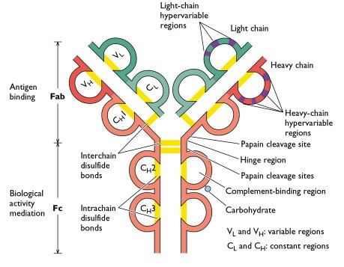
Variable & Constant Regions
Fab fragments: represent the antigen binding fragment of an intact antibody containing both the variable and constant regions of both heavy and light chains
Fc fragments: The fragment crystallizable region (Fc region) is the tail region, that interacts with cell surface receptors called Fc receptors and some proteins of the complement system. Allows antibodies to activate the immune system.
Variable Region: Antigen Binding site
Hyper-variable region: Within the V region there are hot spots that show higher variability in the amino acid sequences. Also known Complementarity determining regions
The site on the HVR that make actual contact with the epitope of the antigen is known as paratope

Slide 10
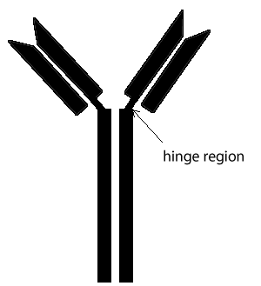
Hinge Region
Permits flexibility between the two arms of the Y-shaped antibody molecule.
This allows them to open and close to accommodate binding to two identical antigens separated by a fixed distance
Rich in proline & cysteine
Highly sensitive to various enzymatic digestions

Slide 11
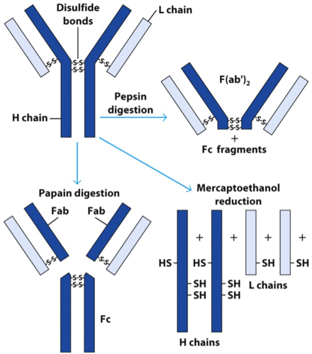
Enzymatic digestion

Slide 12
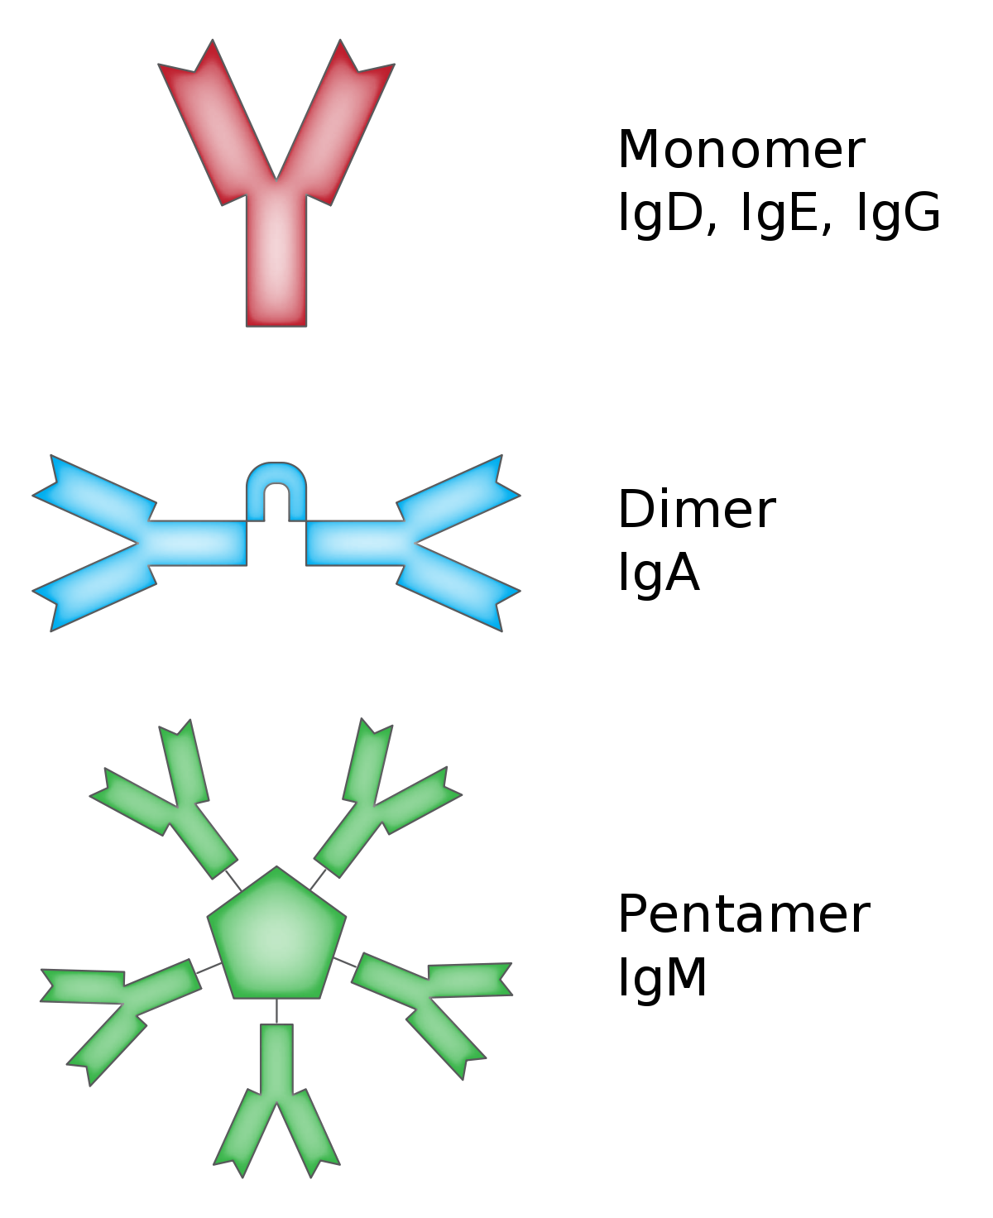
Valency
The valency of antibody refers to the number of Fab regions it possesses thu how many binding sites an antibody may have
Valency 2
Valency 4
Valency 10 (however not more than 5)

Slide 13
CLASSES OF IMMUNOGLOBULINS

Slide 14
  The five primary classes of immunoglobulins are IgG, IgM, IgA, IgD, and IgE.
  These are distinguished by the type of heavy chain found in the molecule.
    IgG molecules have heavy chains known as γ gamma-chains
    IgMs have μ mu-chains;
    IgAs have α alpha-chains
    IgEs have ε epsilon-chains
    IgDs have δ delta-chains.
GAMED

Slide 15
  Differences allow to function in different types of immune responses and at particular stages of the immune response.
  The polypeptide protein sequences responsible for these differences are found primarily in the Fc fragment.
  There are two main types of light chains: kappa (κ) and lambda (λ).
  Antibody classes differ in valency as a result of different numbers of Y-like units (monomers) that join to form the complete protein.
    For example, in humans, functioning IgM antibodies have five Y-shaped units (pentamer) containing a total of ten light chains, ten heavy chains, and ten antigen-binding

Slide 16
Properties | IgG | IgA | IgM | IgD | IgE
Form | Monomer | Mono-, Dimer | Mono-, Pentamer | Monomer | Monomer
MW (Da) | 150,000 | 320,000 | 900,000 | 180,000 | 200,000
Valency | 2 | 2 or 4 | 2 or 10 | 2 | 2
Chains | - | J chain secretory component | J chain | - | -
Sub Classes | G1, G2, G3, G4 | A1, A2 | - | - | -
Half-life days | 23* | 6 | 5 | 3 | 2.5
Intravascular dist (%) | 45 | 42 | 80 | 75 | 50
Classical Complement Act | ++ (IgG3>2>1)- | - | +++ | - | -
Alternate | - | + | - | - | -
Placental Trnfer | + (Except G2) | - | - | - | -
Mediates coagglutination | + (Except G3) | - | - | - | -
Muscosal trnspt | - | + | - | - | -
Mast Cell | - | - | - | - | +

Slide 17
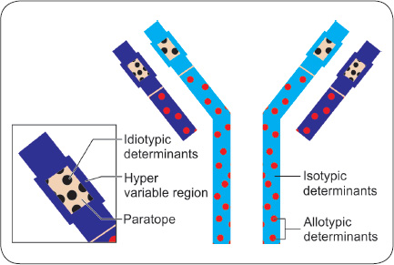
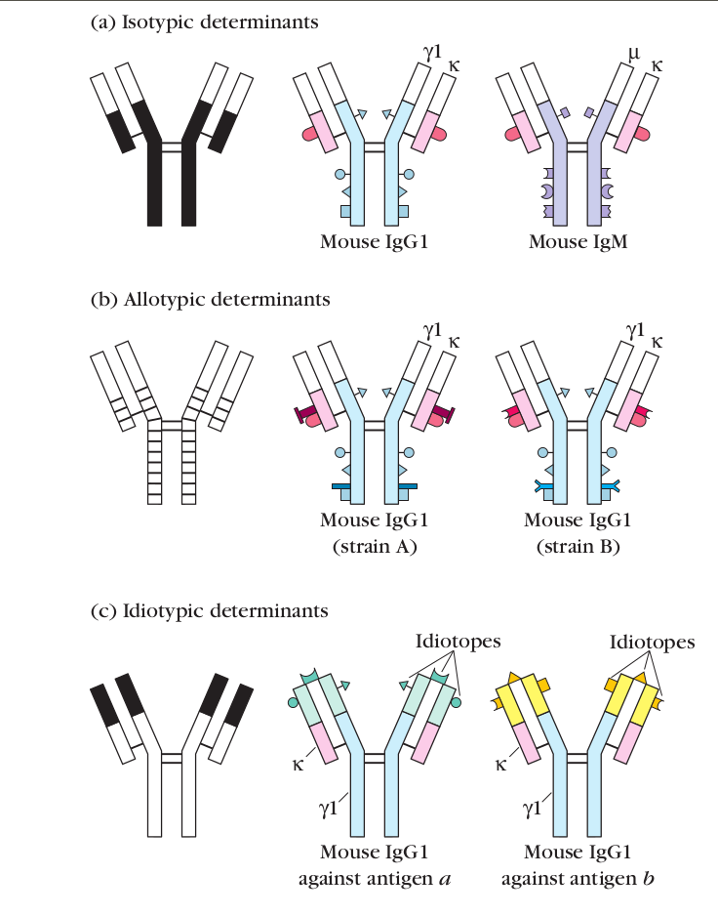
Isotypes
The five classes of IgGs and their subclasses are called “isotypes”
Vary from each other in the amino acid sequences in the constant region of their heavy chains
Isotypes have different heavy chains.
They represent classes of Abs

Slide 18
Idiotype & allotype
Allotypes have same constant region with minor but immunologic differences
Different individuals have difference allotypes
Idiotypes are Abs that recognize different specific epitopes (on the paratope)
Each idiotype is composed of several idiotypes or combining sites

Slide 19
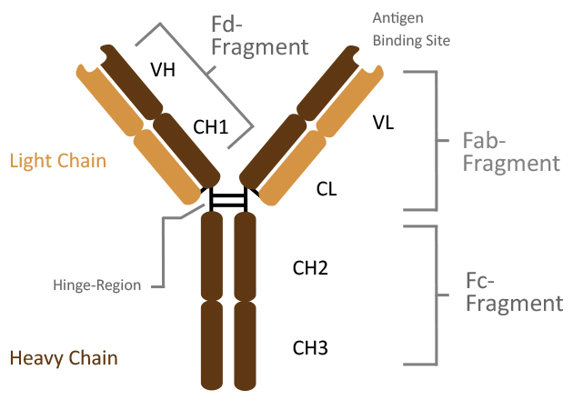
IgG class
  IgG - Immunoglobulin G is the main immunoglobulin
  present in the blood and represents 70% to 75%
  Easily crosses blood vessels & the placental barrier and are responsible for defense against infection in the first few months of a baby's life.
  Provides long term Immunity
  Properties of IgG:
  Molecular weight: 150,000 Da
  H-chain type (MW): gamma (53,000 Da)
  Serum concentration: 10 to 16 mg/mL
  Half-Life: 23 days (time required for ½ Abs to disappear)
  Percent of total immunoglobulin: 75%
  Glycosylation (by weight): 3%
  Distribution: intra- and extravascular
  Function: secondary response
  Single Unit Monomer

Slide 20
Role of IG
IgG is the major immunoglobulin in blood, lymph fluid, cerebrospinal fluid and peritoneal fluid and a key player in the humoral immune response.
Serum IgG in healthy humans presents approximately 15% of total protein beside albumins, enzymes, other globulins, and many more.
The Fc portion of IgG, but not F(ab´)2 or Fab fragments, can cross the placenta of a mother and enter fetal circulation, providing the fetus with postpartum protection.
IgG molecules are able to react with Fcγ receptors (FcγRs) that are present on the surface of macrophages, neutrophils and natural killer cells, and can activate the complement system.
The binding of the Fc portion of IgG to the receptor present on a phagocyte is a critical step in the opsonization. Phagocytosis of particles coated with IgG antibodies is a vital mechanism that cells use to cope with microorganisms.
IgG is produced in a delayed response to an infection and can be retained in the body for a long time. The longevity in serum makes IgG most useful for passive immunization by transfer of this antibody. Detection of IgG usually indicates a prior infection or vaccination.
Notes:
Humoral response : Many of the bacteria that cause infectious disease multiply in the extracellular spaces of the body, and most intracellular pathogens spread by moving from cell to cell through the extracellular fluids.
The extracellular spaces are protected by the humoral immune response, in which antibodies produced by B cells cause the destruction of extracellular microorganisms and prevent the spread of intracellular infections.
Fc-gamma receptors (FcγRs) recognize IgG-coated targets
Cross-linking leads to internalization of the cargo with associated activation of down-stream signaling cascades. ets, such as opsonized pathogens or immune complexes (ICs)

Slide 21
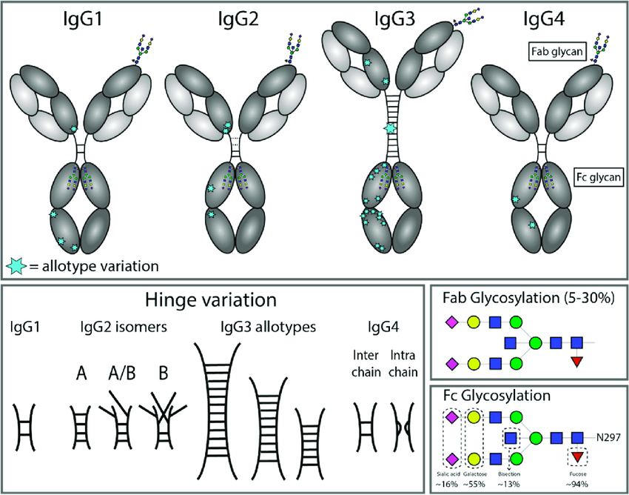
IgG SubClasses
  IgG subclasses are more than 90% identical on the amino acid level
  They a unique profile with respect to structure, antigen binding, immune complex formation, complement activation, triggering of FcγR, half-life, and placental transport
  They differ in the number of disulfide bonds and the length and flexibility of the hinge region.
Notes:
Antibody effector functions are an important part of the humoral immune response and form an essential link between innate and adaptive immunity. Most of these effector functions are induced via the constant (Fc) region of the antibody, which can interact with complement proteins and specialized Fc-receptors.
Antibody Effector Functions
Neutralization occurs when antibodies bind to pathogens or toxins in order to prevent the pathogens from infecting cells.
Opsonization is an immune process which uses opsonins to tag foreign pathogens for elimination by phagocytes.
Complement Activation Complement is a system of plasma proteins that can be activated directly by pathogens or indirectly by pathogen-bound antibody, leading to a cascade of reactions that occurs on the surface of pathogens and generates active components with various effector functions.
Antibody-Dependent Cellular Cytotoxicity (ADCC) also referred to as antibody-dependent cell-mediated cytotoxicity, is a mechanism of cell-mediated immune defense whereby an effector cell of the immune system actively lyses a target cell, whose membrane-surface antigens have been bound by specific antibodies.

Slide 22
  Except for their variable regions, all immunoglobulins within one class share about 90% homology, but only 60% among classes.
  Determination of IgG subclasses can be a valuable tool in indicating a potential antibody deficiency.
  Selective IgG subclass deficiencies are associated with disease with prolonged or severe infections, determination of IgG levels can provide additional insight into the manifestation of disease. It is important to interpret IgG subclass concentrations in correlation to the donor's age since the immune system matures during childhood.
  Because of its relative abundance and excellent specificity toward antigens, IgG is the principal antibody used in immunological research and clinical diagnostics

Slide 23
Definitions & terms
Immune complex formation: An immune complex, sometimes called an antigen-antibody complex or antigen-bound antibody, is a molecule formed from the binding of multiple antigens to antibodies.
Fc-gamma receptors (FcγRs) recognize IgG-coated targets, such as opsonized pathogens or immune complexes (ICs). Cross-linking leads to internalization of the cargo with associated activation of down-stream signaling cascades.
Activating Fc γ receptors (FcγRs) stimulate immune cell effector mechanisms, such as antibody-dependent cell-mediated cytotoxicity (ADCC) and phagocytosis (ADCP), which combine to facilitate antibody-mediated tumor cell killing
Antibody effector functions are an important part of the humoral immune response and form an essential link between innate and adaptive immunity. Most of these effector functions are induced via the constant (Fc) region of the antibody, which can interact with complement proteins and specialized Fc-receptors.
Antibody Effector Functions
Neutralization occurs when antibodies bind to pathogens or toxins in order to prevent the pathogens from infecting cells.
Opsonization is an immune process which uses opsonins to tag foreign pathogens for elimination by phagocytes.
Complement Activation Complement is a system of plasma proteins that can be activated directly by pathogens or indirectly by pathogen-bound antibody, leading to a cascade of reactions that occurs on the surface of pathogens and generates active components with various effector functions.
Antibody-Dependent Cellular Cytotoxicity (ADCC) also referred to as antibody-dependent cell-mediated cytotoxicity, is a mechanism of cell-mediated immune defense whereby an effector cell of the immune system actively lyses a target cell, whose membrane-surface antigens have been bound by specific antibodies

Slide 24
IgG1
Most abundant 60–65%
Mediates antibody responses against viral pathogens
It does so by binding to soluble proteins and membrane protein antigens via its variable domain and activating effector mechanisms of the innate immune system.
IgG1 can effectively bind to C1q causing complement-dependent cytotoxicity (CDC) and can bind to each of the different Fc receptors resulting in antibody-dependent cell-mediated cytotoxicity (ADCC)
relatively high thermostability, monomeric nature, and average flexible hinge region containing only two disulfide bonds.
goal of the therapeutic requires ADCC or CDC (e.g., elimination of cancer cells), IgG1 is preferred.
IgG1 molecules can be engineered with reduced binding to C1q or FcγRs
Notes:
The complement component 1q (or simply C1q) is a protein complex involved in the complement system, which is part of the innate immune system. to bind immune complexes and initiate complement activation producing membrane lytic complexes, opsonins and anaphylatoxins. T

Slide 25
IgG2
IgG2 plays a role in protection against protein antigens but is predominantly responsible for anticarbohydrate IgG responses against bacterial capsular polysaccharides.
IgG2 is limited in its ability to engage effector functions
relatively short hinge region (12 amino acids) containing
four disulfide bonds within the hinge short hinge,
combined with unique disulfide bond isoforms, can
restrict the conformational flexibility of the Fab arms
relative to the Fc portion of the IgG2 molecule
IgG2 can exist in three dominant forms based on its
disulfide configuration: IgG2A, IgG2B, and IgG2A/B
IgG2A is a representative of the canonical Y-shaped IgG
molecule with the disulfide bonds of the Fab portion
being independent of those in the hinge.
IgG2B is more constrained due to the Fab arms being
covalently attached to the hinge via disulfide bonds and can be depicted as a T-shaped molecule
IgG2A/B is a combination of both the A and B forms with one Fab arm being independent of the Fc and the other being covalently attached.

Slide 26
IgG3
comprises around 5–10% of total IgG
IgG3 is very effective at engaging effector mechanisms but represents a relatively small percentage of circulating IgG in human serum
dominant feature of IgG3 is the long hinge connecting the Fab domains to the Fc portion of the molecule.
The hinge of IgG3 is 62 amino acids long, more than four times that of IgG1 and containing 11 disulfide bonds.
They attribute this heightened potency to the long
hinge region of IgG3, facilitating the cross-linking of
the spike protein on the viral surface
long hinge of IgG3 affords it greater flexibility, but also
increased susceptibility to degradation when purified
and as a result has not extensively been examined for
use as a therapeutic molecule
Depending on the allotype of IgG3, its half-life is
considerably less than that of the other subclasses

Slide 27
IgG4
Comprising usually less than 4% of total IgG
IgG4 are believed to constitute a veritable antigen “garbage disposal” system, which can attenuate inflammation or protect against type I hypersensitivity by inhibiting IgE activity, as well as prevent type II and III hypersensitivity by blocking immune complex formation
IgG4 does not bind to polysaccharides

Slide 28
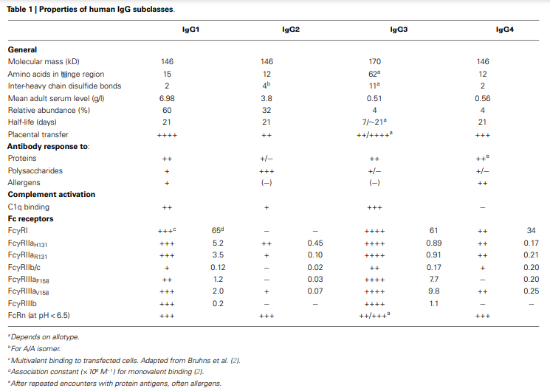

Slide 29
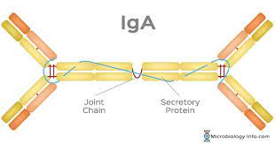
IgA class
IgA exists in serum in both monomeric and dimeric forms, comprising approximately 15% of the total serum Ig.
Secretory IgA, a dimer, provides the primary defense mechanism against some local infections because of its abundance in mucosal secretions (e.g., saliva and tears). The principal function of secretory IgA may be not to destroy antigens but to prevent passage of foreign substances into the circulatory system.
Properties of IgA:
Molecular weight: 320,000 Da (secretory)
H-chain type (MW): alpha (55,000 Da)
Serum concentration: 1 to 4 mg/mL
Percent of total immunoglobulin: 15%
Glycosylation (by weight): 10%
Distribution: intravascular and secretions
Function: protect mucus membranes

Slide 30
Role of IgA
IgA in serum is mainly monomeric, but in secretions, such as saliva, tears, colostrums, mucus, sweat, and gastric fluid. Most present in secreted form.
IgA is found as a dimer connected by a joining peptide.
This is believed to be due to its properties in preventing invading pathogens by attaching and penetrating epithelial surfaces. IgA is a very weak complement-activating antibody; hence, it does not induce bacterial cell lysis via the complement system.
However, secretory IgA works together with lysozymes (also present in many secreted fluids), which can hydrolyze carbohydrates in bacterial cell walls thereby enabling the immune system to clear the infection.
IgA is predominantly found on epithelial cell surfaces where it acts as a neutralizing antibody.

Slide 31
IgA subclasses
IgA1
Comprises approximately 85%
Although IgA1 shows a broad resistance against several proteases, there are some that can affect/splice on the hinge region.
IgA1 shows a good immune response to protein antigens and, to a lesser degree, polysaccharides and lipopolysaccharides.
IgA2
Comprises approximately 15%
Crucial role in the mucosa of the airways, eyes and the gastrointestinal tract to fight against polysaccharide and lipopolysaccharide antigens.
It also shows good resistance to proteolysis and many bacterial proteases, supporting the importance of IgA2 in fighting bacterial infections.

Slide 32
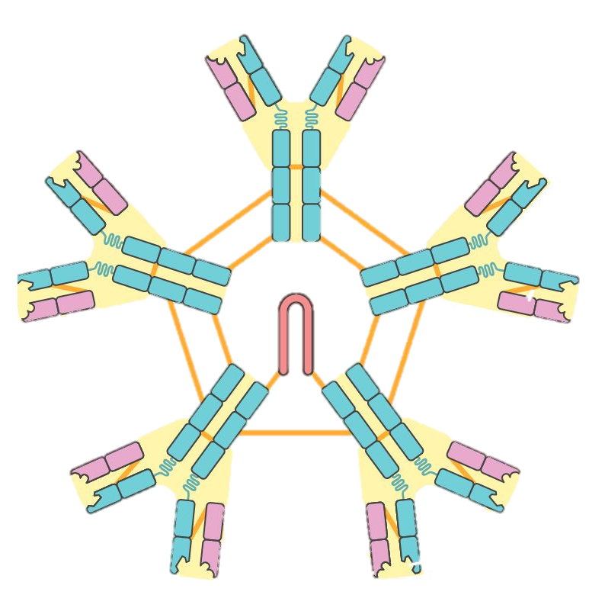
IgM class
IgM is the first class of immunoglobulin made by B cells as they mature
It is the form most commonly present as the antigen receptor on the B-cell surface.
Five of the basic Y-shaped units become joined together to make a large pentamer molecule with 10 antigen-binding sites
Properties of IgM:
Molecular weight: 900,000 Da
H-chain type (MW): mu (65,000 Da)
Serum concentration: 0.5 to 2 mg/mL
Percent of total immunoglobulin: 10%
Glycosylation (by weight): 12%
Distribution: mostly intravascular
Function: primary response
IgM pentamer

Slide 33
Role IgM
Immunoglobulin M is the third most common serum Ig and takes one of two forms:
  a pentamer where all heavy and light chains are identical
  a monomer (e.g., found on B lymphocytes as B cell receptors)
Allows building of bridges between encountered epitopes on molecules that are too distant as to be connected by smaller IgG antibodies.
First antibody built during an immune response.
It is responsible for agglutination and cytolytic reactions
Due to conformational constraints among the 10 Fab portions, IgM only has a valence of 5.
Vital importance in complement activation and agglutination.
IgM is predominantly found in the lymph fluid and blood and is a very effective neutralizing agent in the early stages of disease.
Elevated levels can be a sign of recent infection or exposure to antigen.
IgM is not as versatile as IgG.

Slide 34
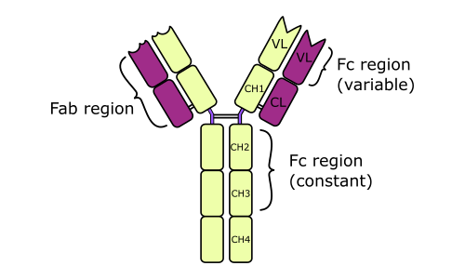
IgE
IgE primarily defends against parasitic invasion and is responsible for allergic reactions.
Properties of IgE:
Molecular weight: 200,000
H-chain type (MW): epsilon (73,000)
Serum concentration: 10 to 400 ng/mL
Percent of total immunoglobulin: 0.002%
Glycosylation (by weight): 12%
Distribution: basophils and mast cells in saliva and nasal secretions
Function: protect against parasites

Slide 35
Role of IgE
The heavy chain of IgE contains an extra domain, by which it attaches with high affinity to Fc epsilon Receptor I (FcεRI) found primarily on eosinophils, mast cells and basophils.
When antigens such as pollen, venoms, fungus, spores, dust mites or pet dander bind with the Fab portion of the IgE attached to the cells, the cells degranulate and release factors like heparin, histamine, proteolytic enzymes, leukotrienes and cytokines.
vasodilatation and increased small vessel permeability causes fluid to escape from capillaries into the tissues, leading to the characteristic symptoms of an allergic reaction.
typical allergic reactions like mucus secretion, sneezing, coughing or tear production are considered beneficial to expel remaining allergens from the body.
Studies have shown that conditions such as asthma, rhinitis, eczema, urticaria, dermatitis and some parasitic infections (e.g., helminths and tapeworms) lead to increased IgE levels
Low levels of IgE can occur in a rare inherited disease that affects muscle coordination (ataxia-telangiectasia).

